Slide 1
MCA 202: Discrete Structures
Instructor
Neelima Gupta
ngupta@cs.du.ac.in

Slide 2
Asymptotically Non-Negative Functions
f(n) is said to be Asymptotically Non-Negative if there exists n₀ ≥ 0 such that
f(n)<0 for all n ≥ n₀
f(n) is said to be Asymptotically Positive if there exists n₀ ≥ 0 such that
f(n)>0 for all n ≥n₀
Asymptotically Positive(/NN) means for large values of x the function is positive(/NN).

Slide 3
An Asymptotically Non-Negative function f(n) is said to be monotonically :
Non-decreasing if
f(n) ≥f(m) whenever n > m
Increasing if
f(n) > f(m) whenever n > m
Similarly,
Non-increasing if
f(n) ≤ f(m) whenever n > m
Decreasing if
f(n) < f(m) whenever n > m

Slide 4
Graphical Representation for Each Case
f(n)
f(m)
f(n)
f(m)
n
m
n
m
monotonically increasing
monotonically decreasing

Slide 5
f(n)
f(m)
f(n)
f(m)
n
m
n
m
monotonically non-decreasing
monotonically non-increasing

Slide 6
Ceiling & Floor
For any real no. x
Floor function is described as : x
i.e. the largest integer less than or equal to x. is called the floor of x
For any real no. x
Floor function is described as : x
i.e. the smallest integer greater than or equal to x. is called the floor of x

Slide 7
For any integer n,
prove n/2 + n/2 = n
Sol^{n}:
If n is even, then n/2 will be integer so it is trivial
n/2 + n/2 =n
if n is odd, then
LHS = (n-1)/2 + (n+1)/2 = (2n-1+1)/2 = n = RHS
Hence proved

Slide 9
Acknowledgement
Anwar Hussain, MCA Semester II 2013

Slide 10
Modulo Function
Modulo Function returns the remainder of division of one number by another.
a=r(mod n) means `a’ gives a remainder of `r’ when divided by `n’.
e.g 13 mod 10 =3
a is stb equivalent to b (mod n)if
a=r(mod n) and,
b=r(mod n)
i.e both a and b give the same remainder when divided by n

Slide 11
Polynomials
A Polynomial is of form f(n)= a_{i}n^{i} where f(n) is asymptotically non negative if ak > 0.
e.g. n³ +n²
Q. To prove f(n)=-n³ +n² is not asymptotically non- negative
Ans . Assume f(n)= -n³+n² is asymptotically non negative(ANN) there exists n_{o} such that
f(n) > 0 for all n > n_{o}
now, as we know –n³+n² <0 for all n>1 which means there exist a n` >n_{o} for which f(n)=-n`³+n`²<0
which contradicts our assumption so f(n) is not ANN.

Slide 12
Exercises:
Is f(n)= 0(f(n/2)) where f(n) is ANN?
Is f(x)= 1+sinx ANN ?

Slide 13
Relation and Function
Exponential Function
Power Function
Thanks Name : Asmita Sharma Roll No : 06 MCA –2012

Slide 14
Relation
If A and B are two sets then a relation R from A to B is a subset of the Cartesian Product A×B.
a
1
b
2
c
3
d
4
e
5
A
B
Relation
Thanks Name : Asmita Sharma Roll No : 06 MCA –2012

Slide 15
Function
A function f from set A to set B is a rule of correspondence that assigns to each element x in the set A exactly one element y in the set B.
In a function, $f\left(x\right)=f\left(y\right)$ iff $x=y$,
this is not the case in a relation
a
1
b
2
c
3
d
4
e
5
A
B
Function
Thanks Name : Asmita Sharma Roll No : 06 MCA –2012

Slide 16
Function
a
1
a
1
b
2
b
2
3
c
3
c
4
d
4
d
5
e
5
A
B
A
B
Not A Function
Not A Function
*One value in A mapped to two
values of B
*One value in A mapped to no
value in B
Thanks Name : Asmita Sharma Roll No : 06 MCA –2012

Slide 17
a
1
a
1
b
2
b
2
c
c
3
d
3
d
4
e
5
Onto Function
One –to -- One
a
1
a
1
b
2
b
2
c
3
c
3
d
4
d
4
e
5
Onto but Not One-to-- One Function
One-to-One but not Onto
Thanks Name : Asmita Sharma Roll No : 06 MCA –2012

Slide 18
a
1
b
2
c
3
d
4
e
5
Bijective Function

Slide 19
Exponential Series
The given infinite series is called the Exponential Series.
$$e^{x}=1+\frac{x}{1!}+\frac{x^{2}}{2!}+\frac{x^{3}}{3!}+…, −∞<x<∞$$
Exponential Function
The function
$f(x)=e^{x}$
, where x is any real number is called an
Exponential Function.
Power function
A power function is a function of the form
$${y=x}^{n}$$
, where x is the variable and n is a constant.
Thanks Name : Asmita Sharma Roll No : 06 MCA –2012

Slide 20
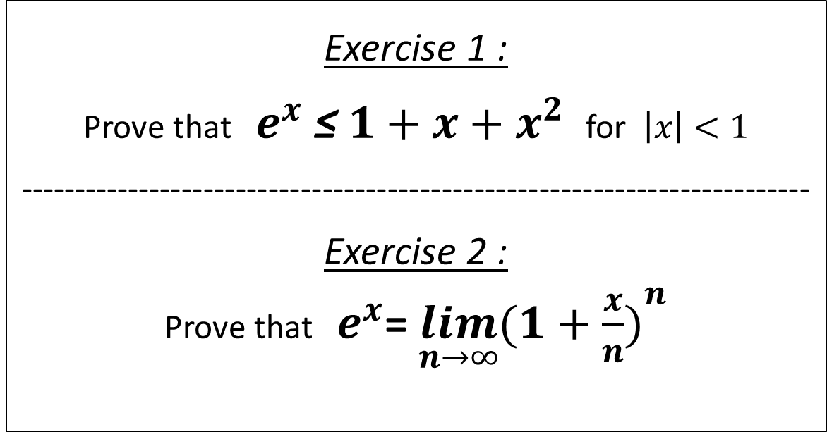
Assignment
Exercise 1 :
Prove that $e^{x}$ ≤ $1+x+x^{2}$for $\left|x\right|<1$
-------------------------------------------------------------------------
Exercise 2 :
Prove that $e^{x}$= $\lim_{n→∞}{{(1+\frac{x}{n})}^{n}}$
Thanks Name : Asmita Sharma Roll No : 06 MCA –2012

